Slide 1
Team 12
Name | ID
Chen Linjiang | A0286052E
Geng Yanrui | A0286024H
Lee Siew Chen | A0287383N
Yao Haihan | A0285864L
Zhang Chi | A0286006H
Zhu Xuanji | A0285889X

Slide 2
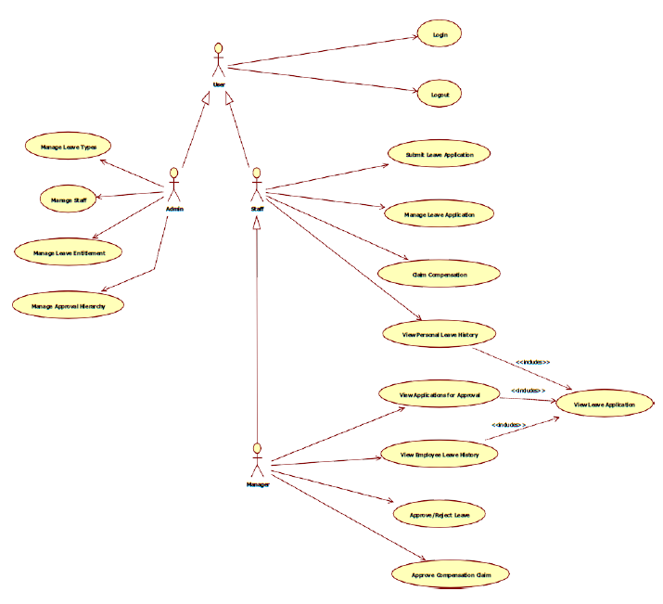
Work Distribution
By actor
Worked in pairs
User and Admin – by Linjiang and Zhang Chi
Staff – by Siew Chen and Xuanji
Manager – by Haihan and Yanrui
Worked as a team to merge the mandatory features and implement optional features

Slide 3
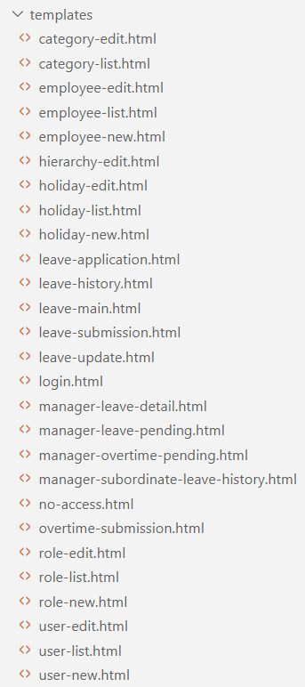
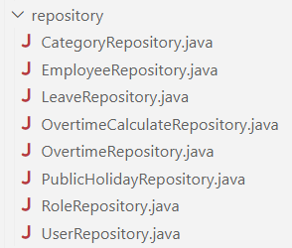

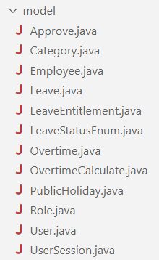
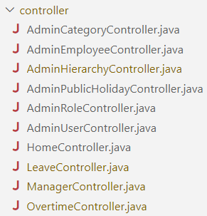
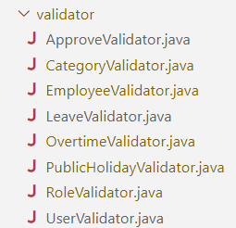
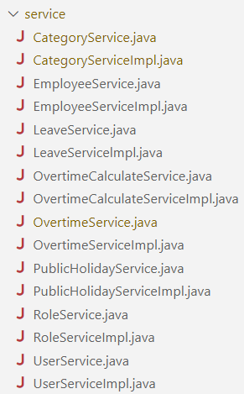
Architecture/Layer Description/Dependencies used

Slide 4
Entity Relationship Diagram
Employee
- employeeId: String - name: String - managerId: String
Role
- roleId: String - name: String - description: String
Approve
- decision: String - comment: String
Overtime
- id: int - employeeId: String - overtimeDate: LocalDate - comeTime: LocalTime - leaveTime: LocalTime - overtimeHours: double - status: LeaveStatusEnum
UserSession
- user: User - employee: Employee - subordinates: List<Employee>
Category
- categoryId: String - name: String - description: String - daysOff: int - differenceForAdmin: int
Leave
- leaveId: int - employeeId: String - fromDate: LocalDate - toDate: LocalDate - numOfDays: int - additionalReasons: String - workDissemination: String - contactDetails: String - comment: String - status: LeaveStatusEnum - category: Category
User
- userId: String - name: String - password: String - employeeId: String - annualLeaveUsed: int - medicalLeaveUsed: int - compensationLeaveUsed: int
OvertimeCalculate
- id: int - employeeId: String - overtimeHours: double - compensationdays: double - approvedCompensationdays: double
PublicHoliday
- holidayId: String - name: String - description: String - fromDate: LocalDate - toDate: LocalDate

Slide 5
Technologies Used
Technology | Tool Name | Software Name
Java SE | JDK | SpringToolSuite4, Visual Studio Code
Spring Framework | STS | SpringToolSuite4, Visual Studio Code
Database | JPA, MySQL | HeidiSQL

Slide 6
Lessons Learnt
How to use github and git for code collaboration and development
Power of learning how to debug which would have saved us a lot of time
Importance of having a good entity/table relationships structure to minimise time spend to edit and ensure consistency when a data field changes
Collaborate in a team for project development to allocate tasks effectively, and facilitate teamwork among team members
Usefulness of the official Spring documentation in helping to resolve coding issues that we are unable to solve with the knowledge we gained in class

